Slide 1
LESSON 8
Inspiring Introductions
for a
Persuasive Speech

Slide 2
Review – Persuasive speech
Purpose
Three types
Organization
To change belief, attitude, action
Fact, value, policy
Problem/solution/benefit
Position/action/benefit

Slide 3
Functions of an inspiring introduction
Gain the audience’s attention
Help the audience understand your position
Have an overview of your points

Slide 4
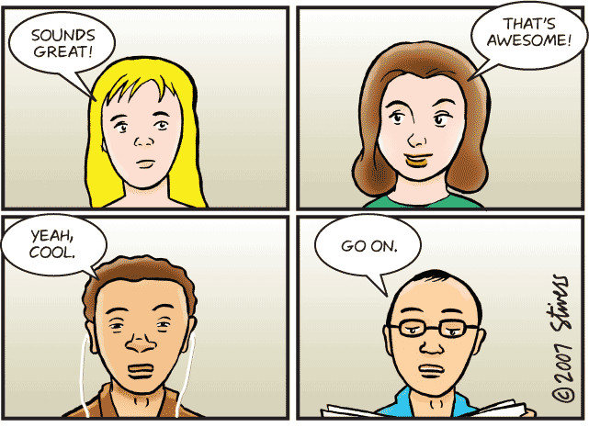
Have you inspired them?

Slide 5
TEMPLATE FOR INTRODUCTION
Greeting and thank-you
Self-introduction
Attention getter
Topic connection
Credibility
Preview
Time for Q&A
Transition

Slide 6


BASIC ELEMENTS
Get audience’s attention with the hooks
Hold their attention with credibility, topic connection and a preview.

Slide 7
5 EFFECTIVE HOOKS
Anecdotes
Statistics
Analogy
Rhetorical questions
Quotation

Slide 8

Task: Make an inspiring introduction
WHEN PASSION BECOMES ADDICTION

Slide 9
Attention-getter 1: Give an anecdote
Speakers who talk about what life has taught them never fail to keep the attention of their listeners.
Dale Carnegie

Slide 10
Attention-getter 1: Give an anecdote
“When you talk about addiction, the first things that come to your mind are usually alcohol or drugs. But I wasn’t addicted to alcohol or drugs. I was addicted to something not real; that is social networking. However, this psychological addiction is as dangerous and harmful as the other physical addictions. The problem came in when my routines were neglected, when my school work called, when my social relationships demanded my attention but I chose Facebook over those concerns. And can you guess what would happen?"

Slide 11
Attention-getter 2: Use a startling statistic
You will get good attention and people will be more inclined to listen to you if you can make a statement whereby their response is…
“No kidding!”
Gael Boardman

Slide 12
Attention-getter 2: Use a startling statistic
According to a statistic given by Facebook itself, each month, 30 billion pieces of content like photos, videos, web links, news stories, and blog posts are shared on Facebook! If every place of content was printed out on a sheet of paper and placed side by side, it would reach the moon 16 times! 16 times, can you imagine?

Slide 13
Attention-getter 3: Use an analogy
One good analogy is worth three hours discussion.
Dudley Field Malone

Slide 14
Attention-getter 3: Use an analogy
Whether you want to deny it or not, you must agree with me that most of us young people are more or less addicted to Facebook. Just like an addict to drugs, we need more and more of the drug to keep us satisfied. Even worse, just like an addict to drugs, we cannot function normally without them. Teenagers call Facebook vitamin F but for me, I prefer to call it a psycho drug. Facebook is killing us softly!

Slide 15
Attention-getter 4: Ask a rhetorical question
Using rhetorical questions in speeches creates a chatty style and closeness with the audience.

Slide 16
Attention-getter 4: Ask a rhetorical question
How many of you here have ever surfed Facebook until midnight? More than a half or maybe most of you, am I right?
And how many of you here have eaten with Facebook, slept with Facebook, and “studied” Facebook in the classroom? More than half of you, am I right?

Slide 17
Attention-getter 5: Use a quotation
A speech with inspirational quotations shows your deep thought and careful research on the topic.

Slide 18
Attention-getter 5: Use a quotation
How can you know your love for Facebook has turned into a kind of addiction? Let me share with you a quotation that I have collected from a forum for F-addicts. “You know you are addicted to Facebook when you log off Facebook, turn your computer off, go to bed, roll over, and log onto your Facebook from your phone one last time for the night!”

Slide 19
A persuasive preview
- Helps the audience feel the need
Shows how to satisfy their need
Describe the benefits they may gain
PROBLEM – SOLUTION - BENEFIT
Or:
POSITION – ACTION - BENEFIT

Slide 20
Task: Make a persuasive preview
WHEN PASSION BECOMES ADDICTION!

Slide 21
Sample persuasive preview
In my talk today, I have planned to cover three main points.
First, I want you to see how Facebook obsession can take away the beautiful or important things that you deserve in your student life.
Second, I’ll show you how to turn this obsession back into a lovely passion.
And last, you’ll see how much you can gain if you just support Mark Zuckerberg to a moderate extent.
PROBLEM
SOLUTION
BENEFIT

Slide 22
Assignment: A full introduction script
RING OUT 2023, RING IN 2024
Plan a dynamic event around the year end to revitalize IUers spirit for the new year.
Write a persuasive introduction with the Preview format: Problem-Solution-Benefit
Notes:
- Indicate a technique for the attention-getter
- Pay more attention to elements 4, 5, 6 in the template

Slide 23
Link to submit:
Group 24
https://drive.google.com/drive/folders/13VBhpZn-EBb1PethfgZGpPjBFSbP11du?usp=sharing

Slide 24
Introduction template
Greeting and thank-you: Good afternoon, everyone. We really appreciate you guys for taking time to listen to our talk.
Self-introduction: We’re …
Attention getter (rhetorical questions):
Topic connection:
Credibility:
Preview
In our talk today, we have planned to cover three main points:
First,
Second,
Finally, Time for Q&A
Our presentation will be about 6-8 minutes. After our speech, if you have any questions or concerns, please feel free to share with us.
Transition
Now we’ll begin the first part:

